Slide 1

Automating Application Packaging and Deployment in SCCM
Andrew Jimenez
Twitter: @AndrewJimenez_

Slide 2
Goal and Overview
Goal: Automatically download, package, distribute, and deploy commonly updated applications in SCCM.
SCCM Application Packager Script
Overview
Recipes
Packaging Process
Final Results
Dynamic Application Deployment During OSD
Overview
Collecting Applications
Selecting Applications
Installing Applications
Putting Everything Together

Slide 3
SCCM Application Packager Script
Downloads, Packages, Distributes and Deploys Common Applications
PowerShell script that only uses built-in functions of SCCM – Nothing to install
Requires access to the internet for downloads and cmdlet and WMI access to SCCM Primary Site
Uses “recipes” to provide instructions on building each application
Applications are able to take advantage of most features
MSI and Script type deployment types
Multiple deployment types in an application
Most detection method types are supported as well as multiple detection methods
Multiple requirements are supported
Creates new Global Conditions, if needed

Slide 4



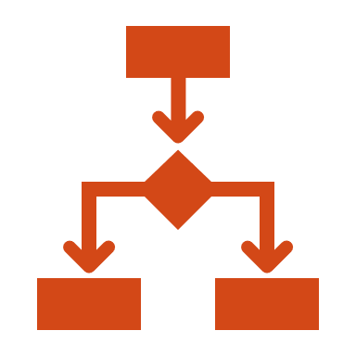
Recipes - Ingredient List
Application Information
Downloads
Deployment Types
Distribution and Deployment
Application Name
Description
Publisher and URL
Icon
Fetch the Latest
URL of the Latest
Check the Version
Deployment Type
Install/Uninstall Commands
Detection Methods
Requirements
Distribute and/or Deploy
Locations for Distribution and/or Deployment

Slide 5
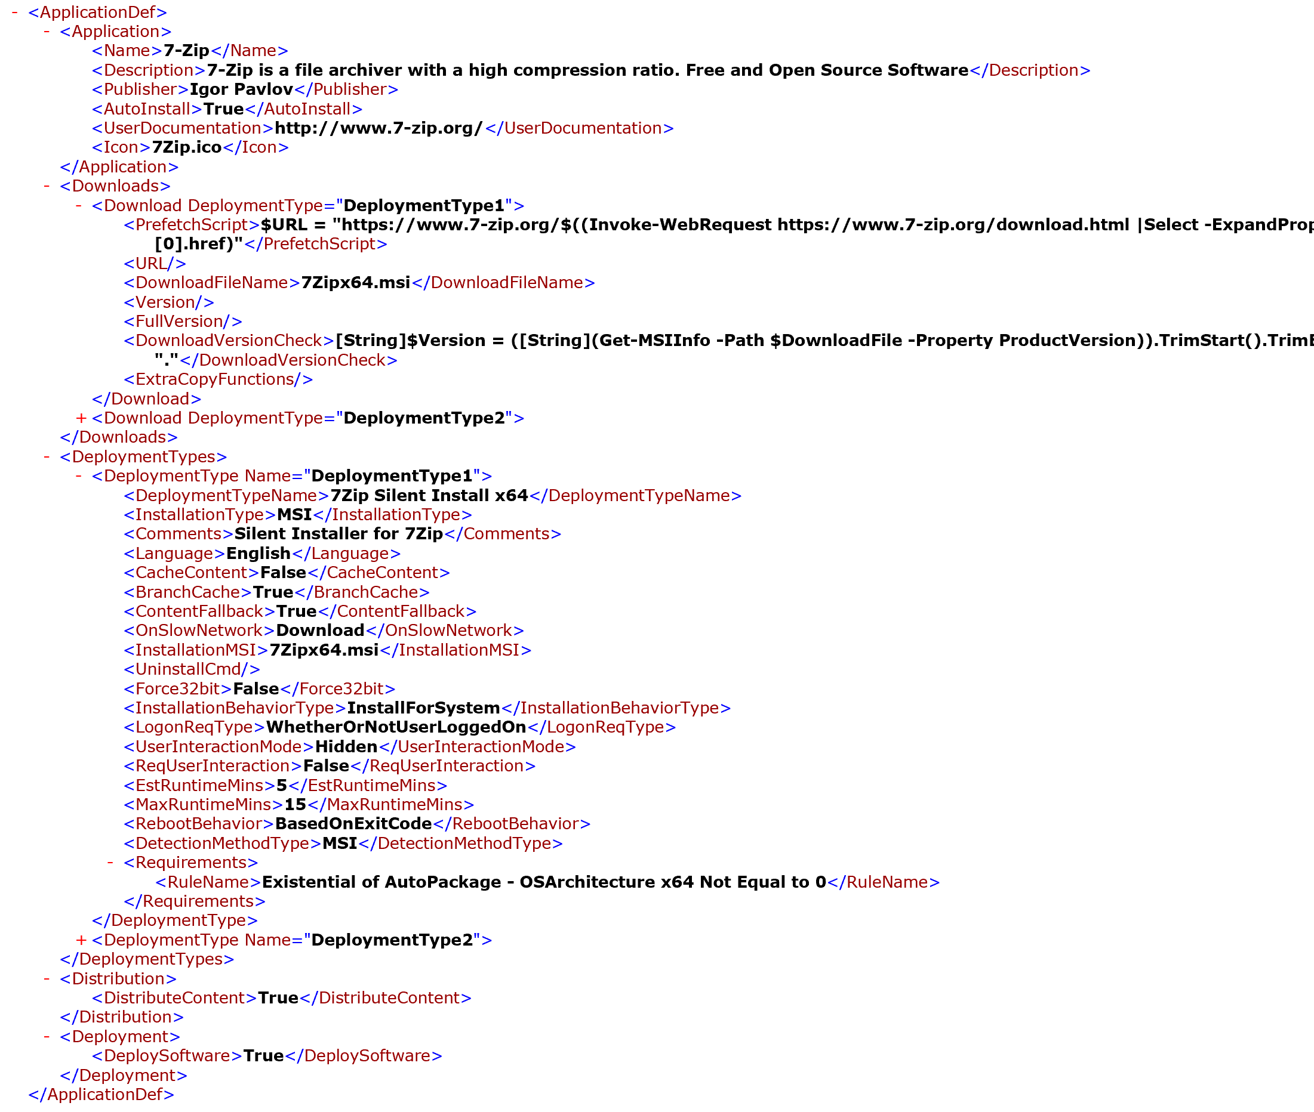
Example Recipe
Application Information
Downloads
Deployment Types
Distribution and Deployment

Slide 6
Packaging Process
Download the Installer
Prefetch script – PowerShell to determine the URL of the latest installer
Download URL – download the installer specified
Version Check – PowerShell to determine the version of the download
Copy Installer and Extra files to Deployment Share
Create the Application
Creates the Application in SCCM, uses the name, description, icon, etc.
New-CMApplication
Creates the SCCM Application
No deployment types are created here.
All information shown in Software Center is set here

Slide 7
Deployment Types
Deployment Type… Types
New-CMScriptDeploymentType
New-CMMSIDeploymentType
Installation and uninstallation commands and properties
Requirements
Copied from a template application
Pre-1810, creating requirements directly on applications was not an easy task
Post 1810, creating requirements for applications is easier, but the template application remains
Post-1810, the template application can be created (almost) entirely with PowerShell
Detection Methods
All types of detection methods are supported – File/Folder, Registry, MSI, etc.

Slide 8
Detection Methods
# Choose the Detection Method Command
Switch ($detMethodDetectionClauseType) {
Directory {
$detMethodCommand = "New-CMDetectionClauseDirectory"
If (-not([System.String]::IsNullOrEmpty($DetectionMethod.Name ))){
$detMethodCommand += " -DirectoryName `'$($DetectionMethod.Name)`'"}}
File {
$detMethodCommand = "New-CMDetectionClauseFile"
If (-not([System.String]::IsNullOrEmpty($DetectionMethod.Name))) {
$detMethodCommand += " -FileName `'$($DetectionMethod.Name)`'"
}}
RegistryKey {
$detMethodCommand = "New-CMDetectionClauseRegistryKey"}
RegistryKeyValue {
$detMethodCommand = "New-CMDetectionClauseRegistryKeyValue"}
WindowsInstaller {
$detMethodCommand = "New-CMDetectionClauseWindowsInstaller” }
}
# Build the Command Line Based on options specified in the recipe
If (([System.Convert]::ToBoolean($DetectionMethod.Existance)) -and (-not ([System.String]::IsNullOrEmpty($DetectionMethod.Existance)))) {
$detMethodCommand += " -Existance"}
If (([System.Convert]::ToBoolean($DetectionMethod.Is64Bit)) -and (-not ([System.String]::IsNullOrEmpty($DetectionMethod.Is64Bit)))) {
$detMethodCommand += " -Is64Bit"
}

Slide 9
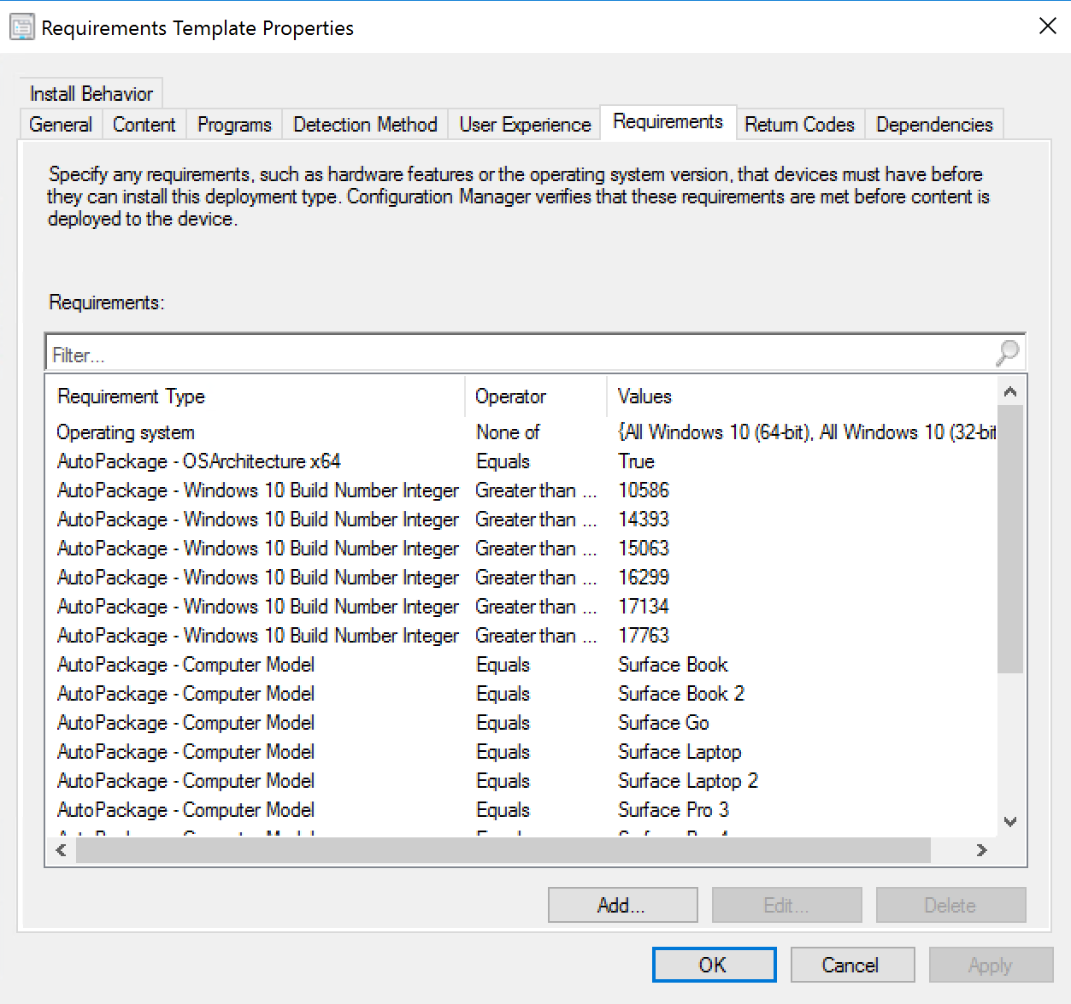
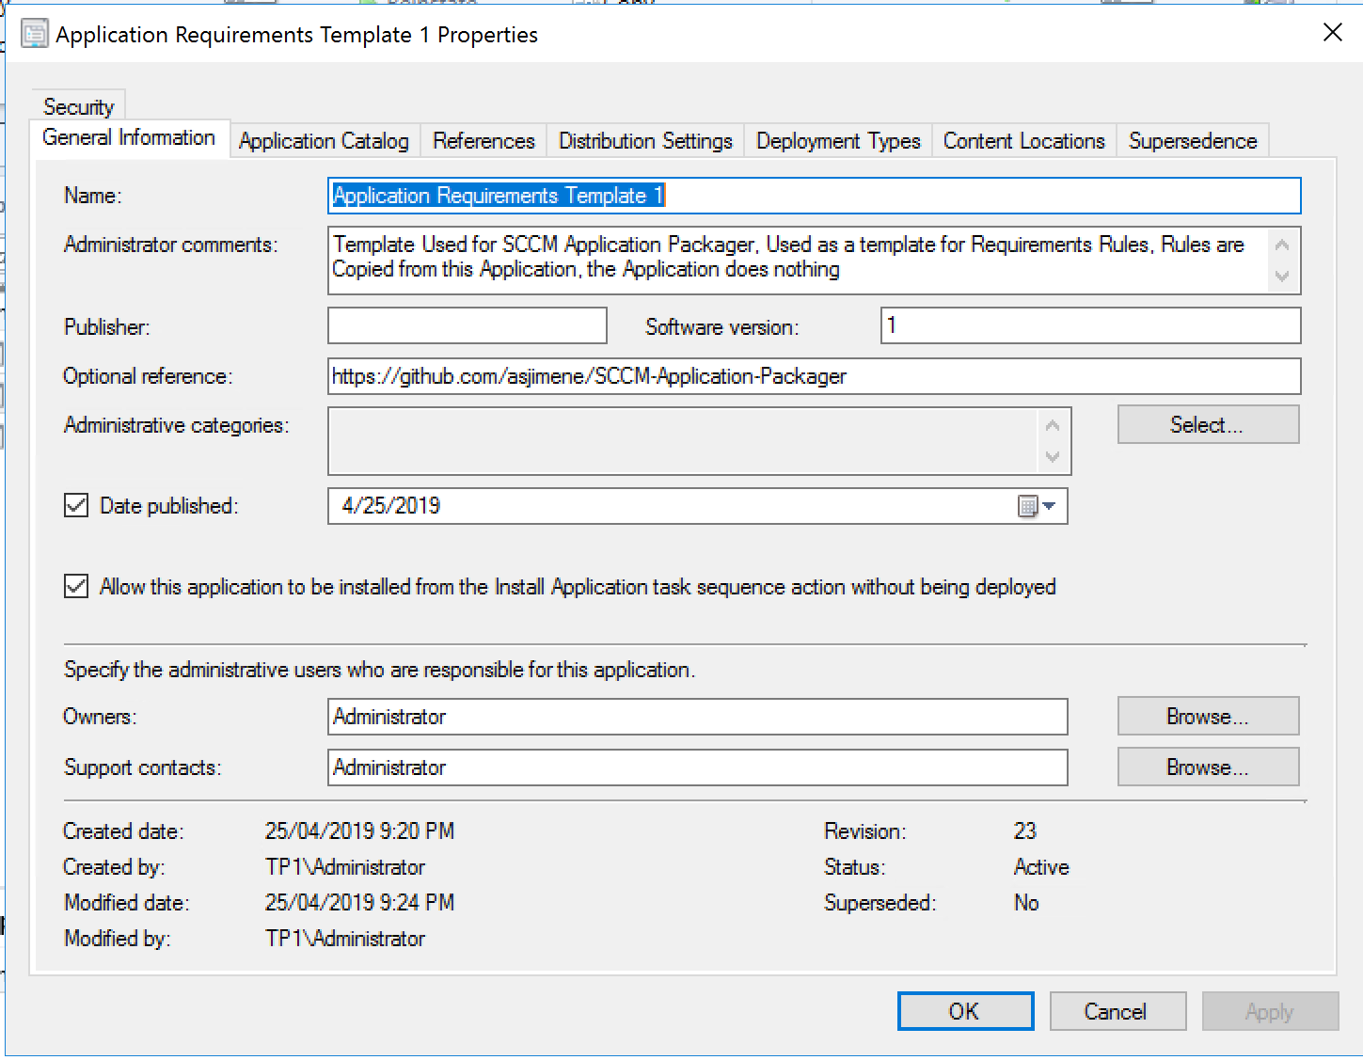
Copying Requirements

Slide 10
Copying Requirements
# get the applications
$SourceApplication = Get-CMApplication -Name $SourceApplicationName | ConvertTo-CMApplication
$DestApplication = Get-CMApplication -Name $DestApplicationName | ConvertTo-CMApplication
# Get DestDeploymentTypeIndex by finding the Title
$DestApplication.DeploymentTypes | ForEach-Object {$i = 0 } {
If ($_.Title -eq "$DestDeploymentTypeName") {
$DestDeploymentTypeIndex = $i }
$i++
}
$Available = ($SourceApplication.DeploymentTypes[0].Requirements).Name
# Get requirement rules from source application
$Requirements = $SourceApplication.DeploymentTypes[0].Requirements | Where-Object { ($_.Name).TrimStart().TrimEnd() -eq $RuleName }
if (-not ([System.String]::IsNullOrEmpty($Requirements))) {
$Requirements = $SourceApplication.DeploymentTypes[0].Requirements | Where-Object { $_.Name -match $RuleName }
}
# apply requirement rules
$Requirements | ForEach-Object {
$RuleExists = $DestApplication.DeploymentTypes[$DestDeploymentTypeIndex].Requirements | Where-Object {$_.Name -match $RuleName}
if($RuleExists) {} else{
# create new rule ID
$_.RuleID = "Rule_$( [guid]::NewGuid())"
$DestApplication.DeploymentTypes[$DestDeploymentTypeIndex].Requirements.Add($_)
}}
$CMApplication = ConvertFrom-CMApplication -Application $DestApplication
$CMApplication.Put()

Slide 11
Distribution and Deployment
Distribute the new application to a specified distribution point group
A default distribution point group can be specified if no group is specified in the recipe
Uses Start-CMContentDistribution
Deploy the application to a specified collection
A default collection can be specified if no collection is specified in the recipe
A test collection is recommended to ease the testing process
Uses New-CMApplicationDeployment

Slide 12
Distribution and Deployment
New-CMApplicationDeployment -CollectionName $Global:PreferredDeployCollection -Name "$ApplicationName $ApplicationSWVersion" -DeployAction Install -DeployPurpose Available -UserNotification DisplaySoftwareCenterOnly -ErrorAction Stop
Start-CMContentDistribution -ApplicationName "$ApplicationName $ApplicationSWVersion" -DistributionPointGroupName $DistributionGroup -ErrorAction Stop
Start-CMContentDistribution -ApplicationName "$ApplicationName $ApplicationSWVersion" -DistributionPointName $DistributionPoint -ErrorAction Stop

Slide 13
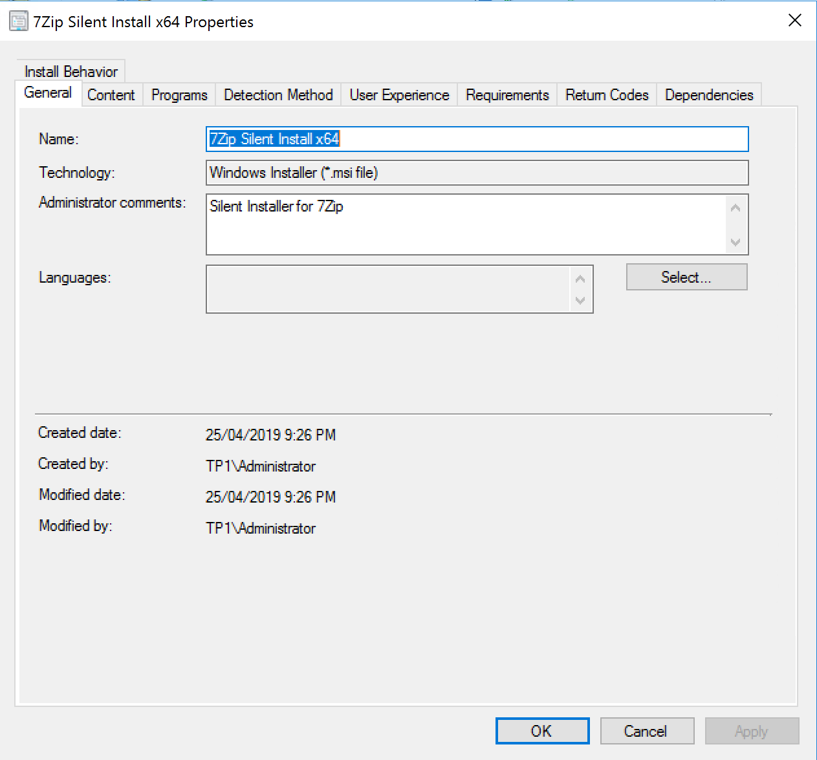
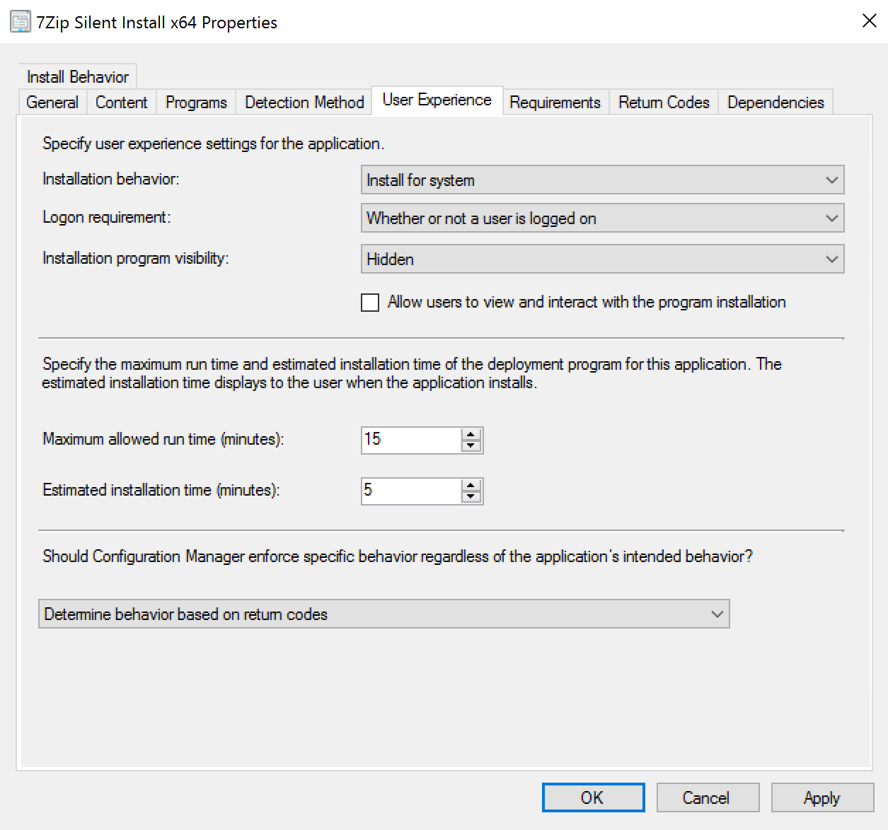
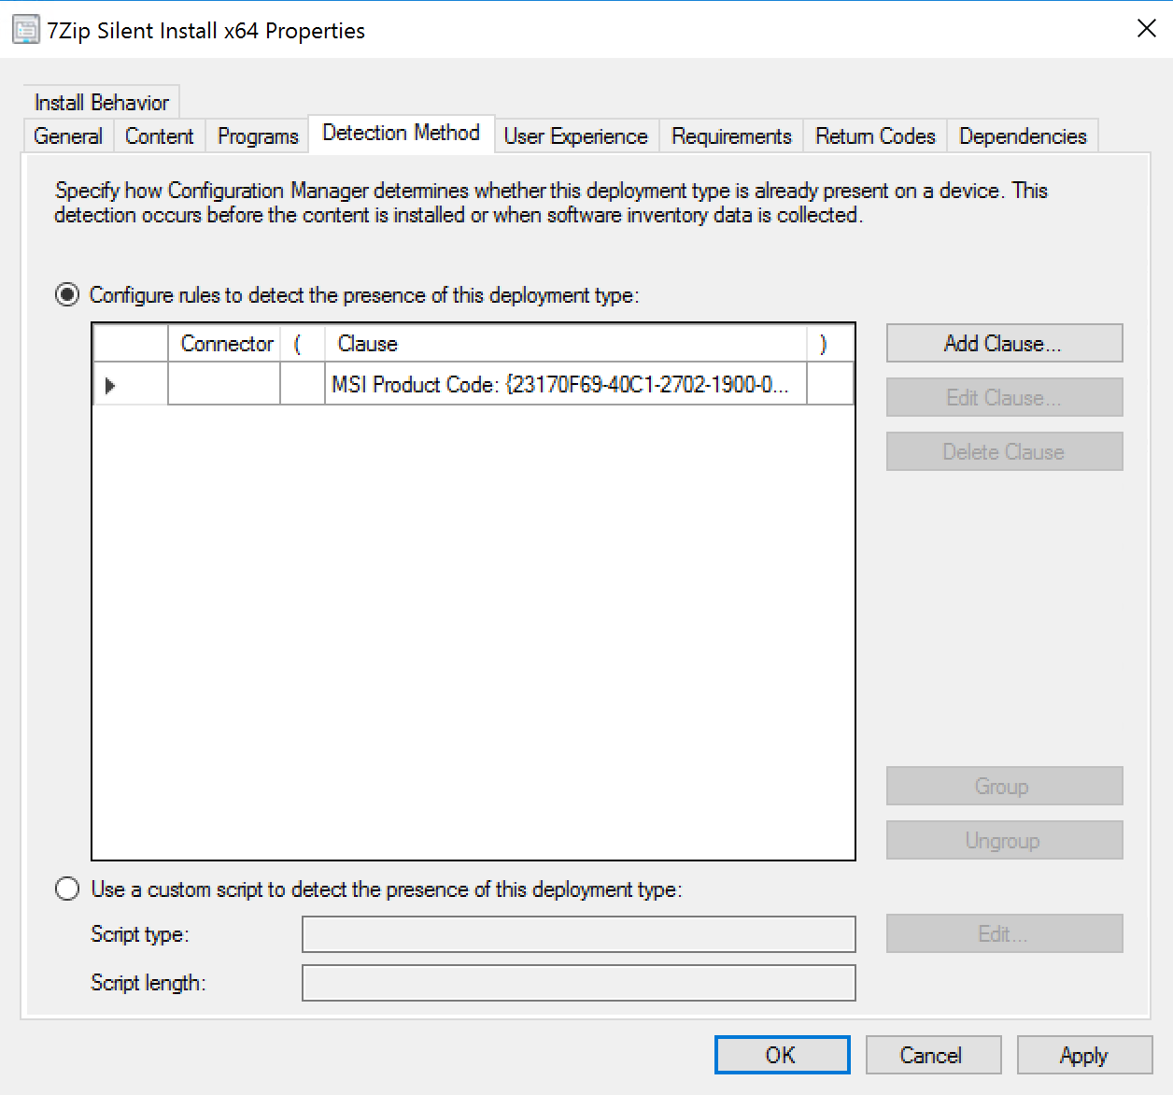
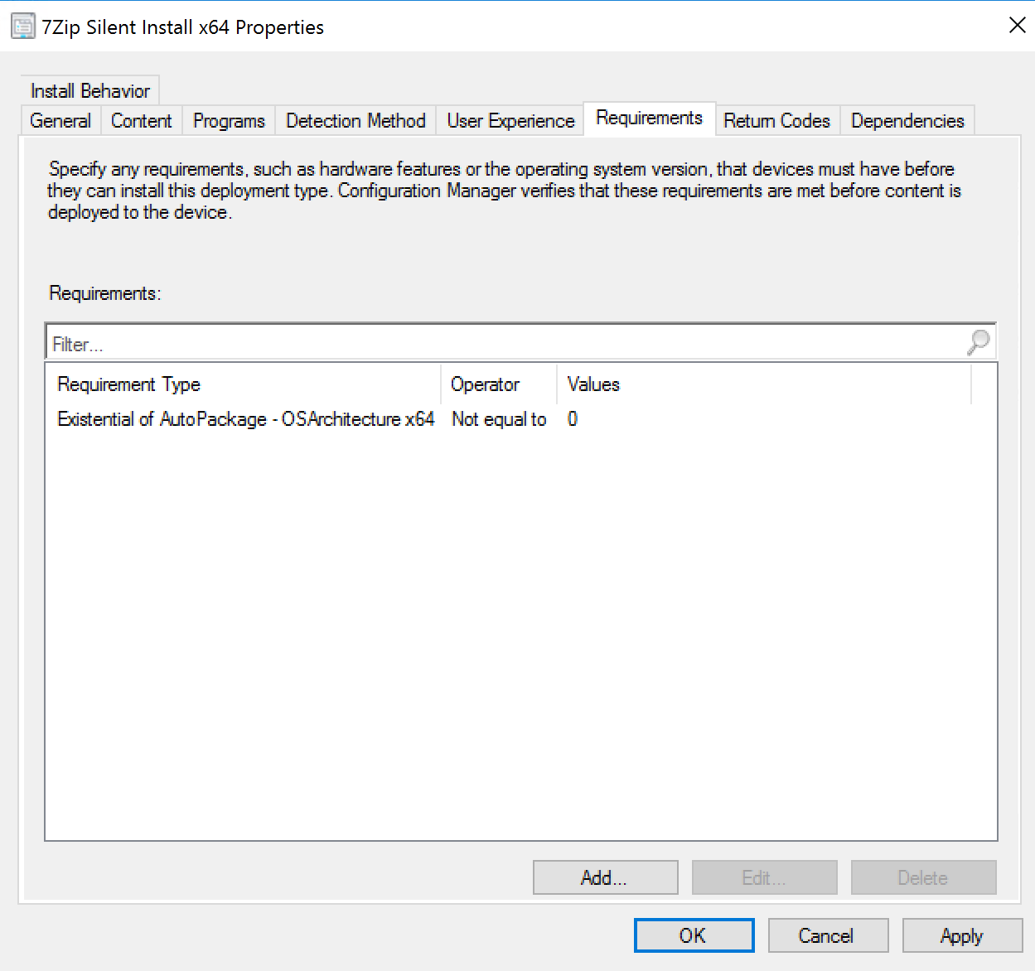
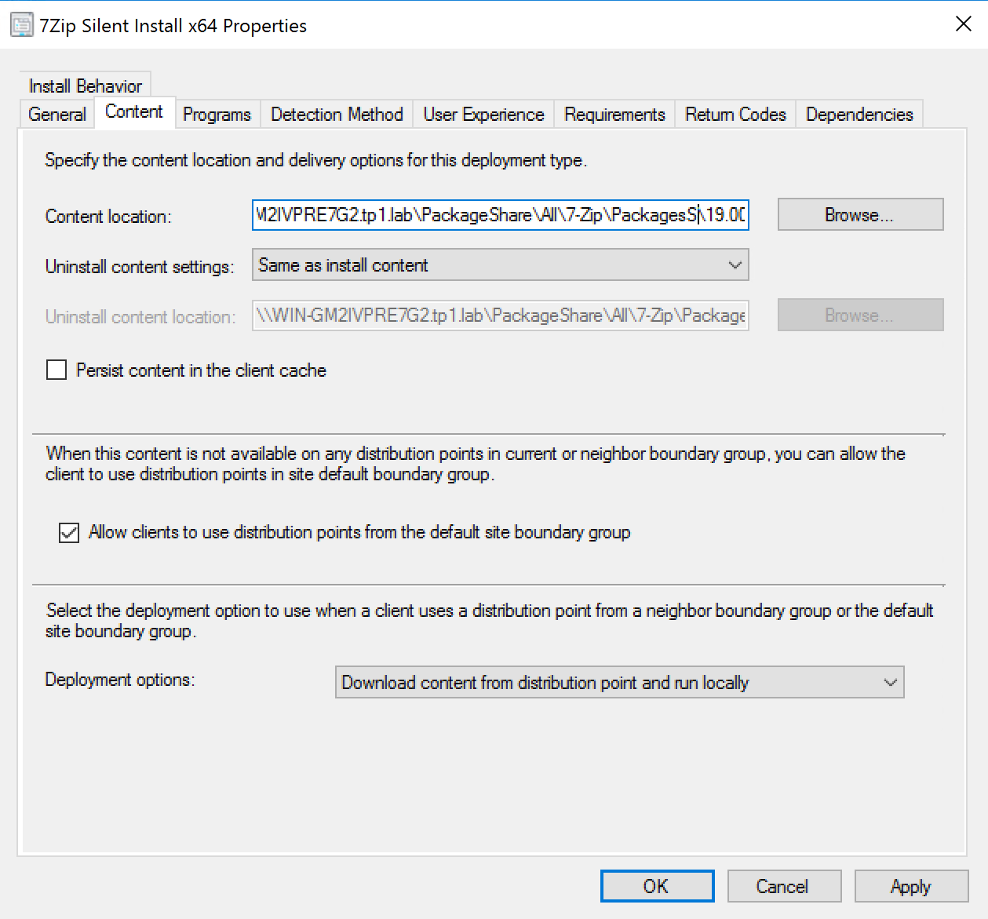
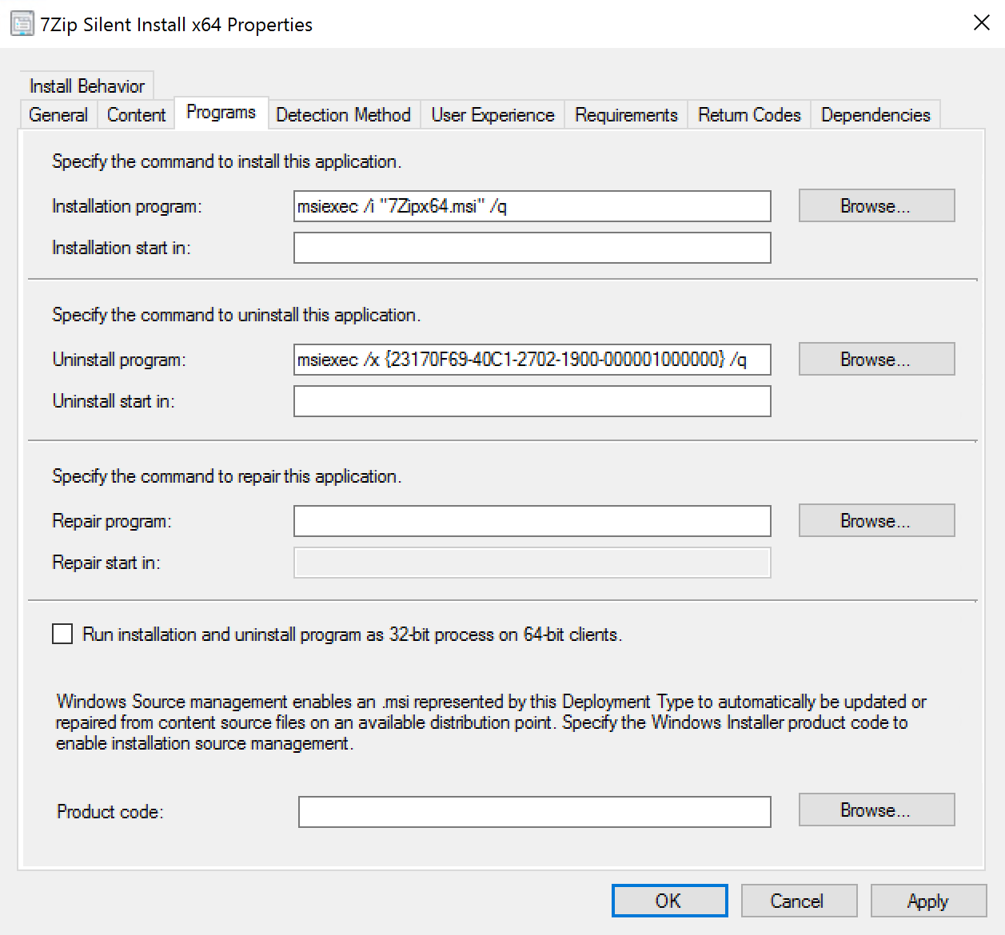
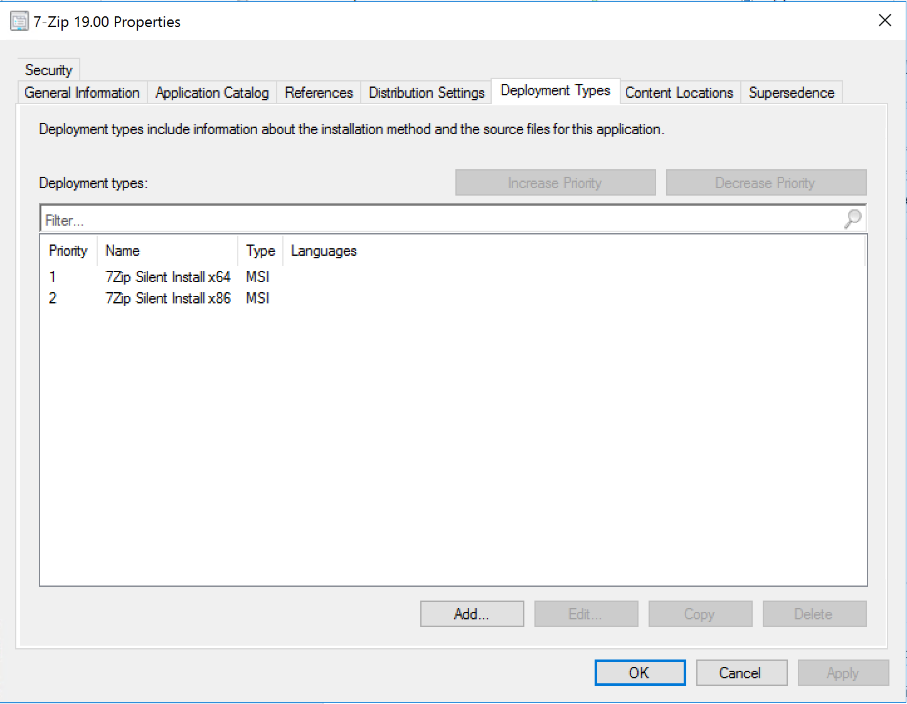
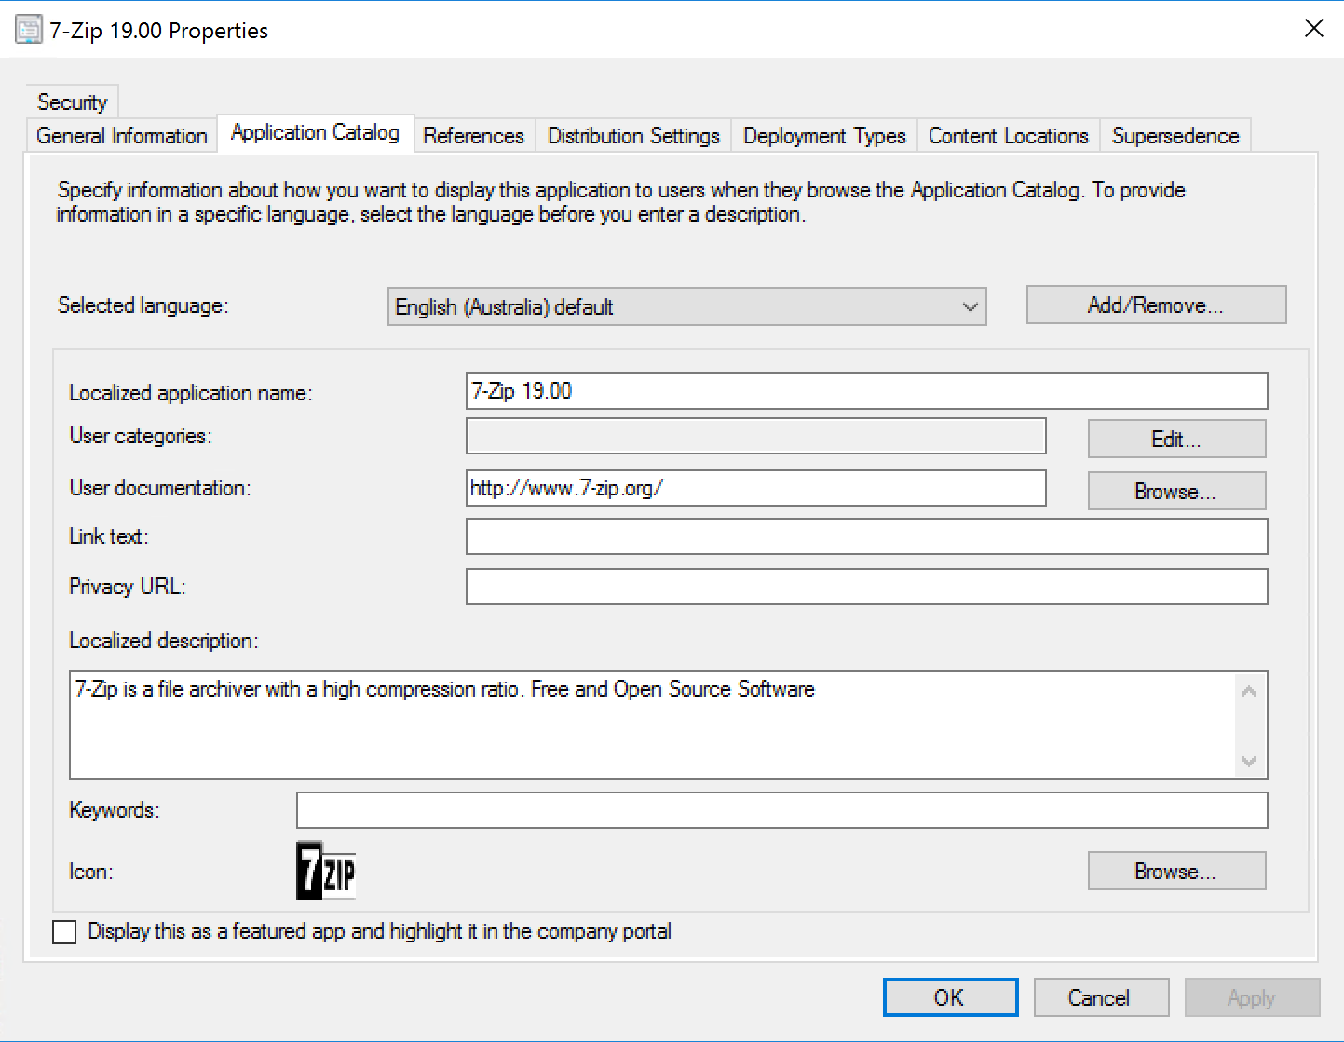
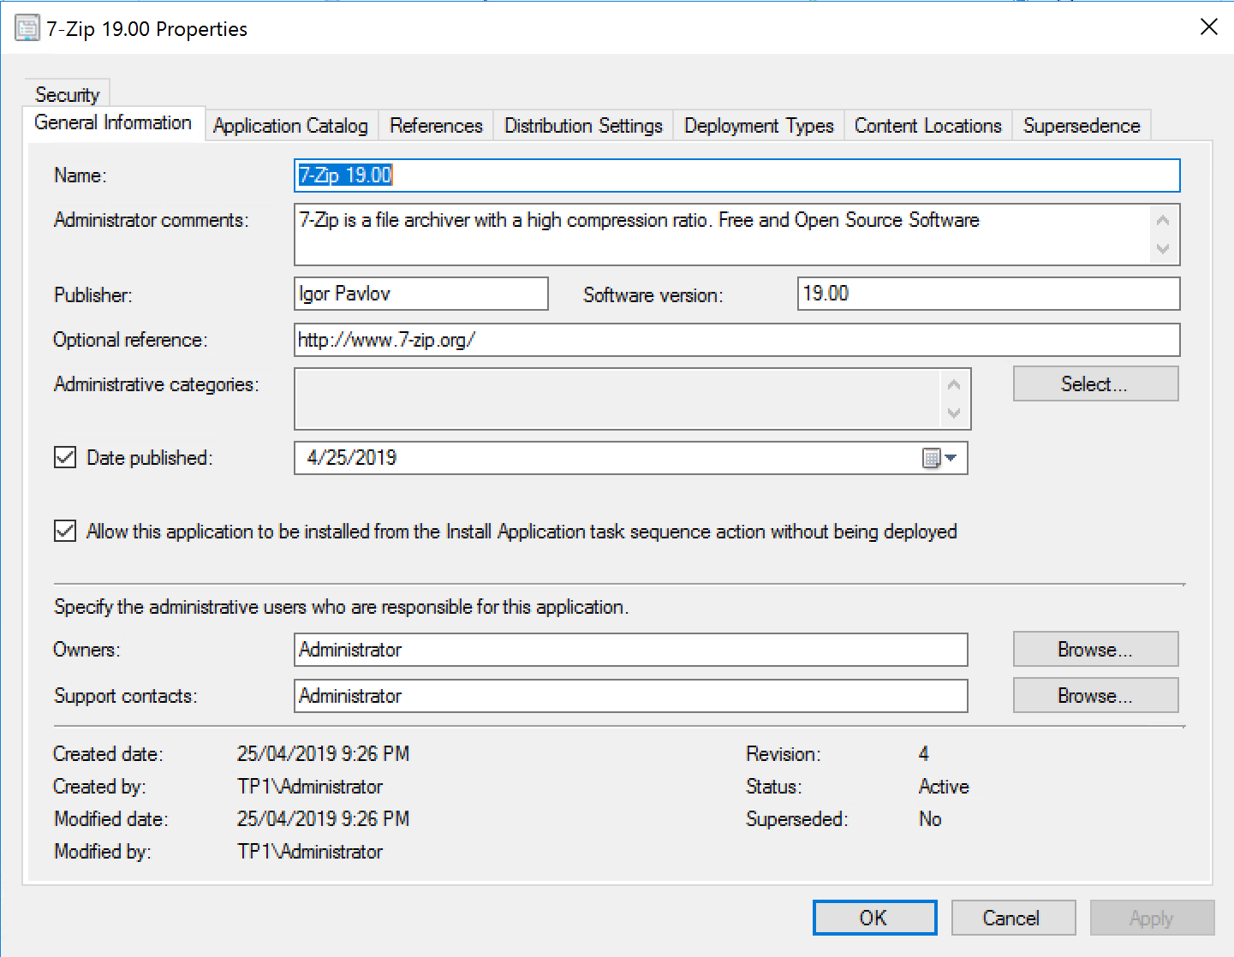
Final Result

Slide 14
Dynamic App Deployment During OSD
Ensuring the latest software versions are Deployed

Slide 15
Goal and Process Overview
Goal: Deploy the latest packaged and tested applications during Operating System Deployment
Process Overview:
Before OSD:
Package applications with SCCM Packager Script
Test applications and set them as “Ready”
Collect applications that are ready for deployment
During OSD:
Determine what applications are required
Determine the latest version of each application required for the deployment
Add required applications to dynamic variable list
Install required applications

Slide 16
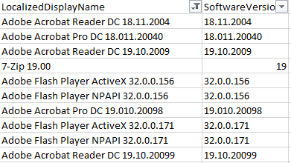
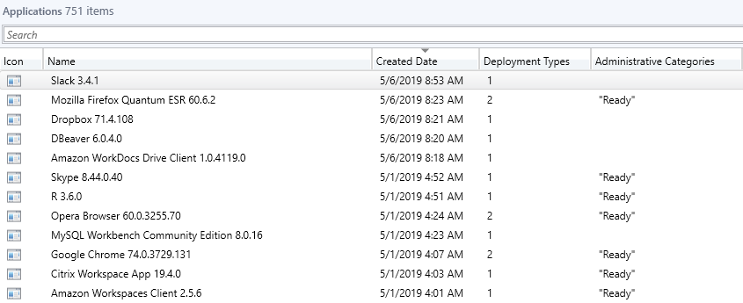
Collecting Applications
After the SCCM Application Packager script packages new applications, they should be tested.
Applications that are tested successfully are categorized as “Ready”
Script runs nightly to gather all “Ready” applications and saves them to a CSV
CSV is copied to a share that is available during OSD
This could also be rolled into a web service

Slide 17
Collecting Applications
# Update All Available Applications List
Write-Output "----------- $(Get-Date -Format G) Gathering All Applications List -----------" >> $Global:LogFile
Write-Output "----------- $(Get-Date -Format G) ScriptRoot = $Global:ScriptLocation -----------" >> $Global:LogFile
Push-Location
Set-Location ASU:
$ApplicationsList = Get-CMApplication -Fast | Where-Object -Property NumberOfDeploymentTypes -ge 1 | Where-Object -Property LocalizedCategoryInstanceNames -Contains "Ready" | Where-Object -property IsExpired -eq $false | Select-Object LocalizedDisplayName, SoftwareVersion
Pop-Location
Write-Host $ApplicationsList
if (-not ([System.String]::IsNullOrEmpty($ApplicationsList[0]))) {
Write-Output "$(Get-Date -Format G) - Exporting Application CSV" >> $Global:LogFile
$ApplicationsList | Export-Csv -Path "$Global:ScriptLocation\ApplicationsList.csv" -NoTypeInformation -Force
} else {
Write-Output "$(Get-Date -Format G) - No Applications found in list, not exporting" >> $Global:LogFile
}

Slide 18
Selecting Applications
During OSD Applications for installation must be selected and added to the dynamic variable list
Done during the naming portion of OSD with a PowerShell script
Default applications are specified for the build
Depending on the department the computer belongs to, additional applications can be specified
Once the department and installation options are set the dynamic variables are set with a script that:
Loops through the list of selected applications
Selects the latest version of each application specified
Creates Task Sequence Variable with the Application Name

Slide 19
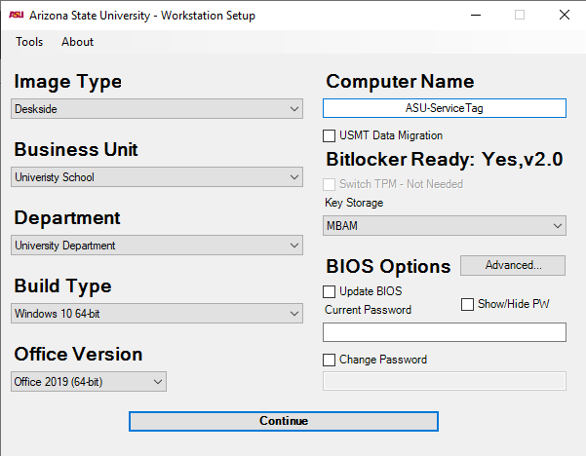
Selecting Applications
Dynamic Variables List:
ENTAppDeploy01 = Microsoft Office Professional Plus 64-bit 2019
ENTAppDeploy02 = Microsoft CMTrace
ENTAppDeploy03 = Google Chrome 74.0.3729.131
ENTAppDeploy04 = Adobe Acrobat Reader DC 19.10.20099
ENTAppDeploy05 = Mozilla Firefox Quantum ESR 60.6.1
ENTAppDeploy06 = VLC Media Player 3.0.6

Slide 20
Selecting Applications
# Default Apps Processing
foreach ($Application in $DefaultApps.Split(",")) {
$AppToInstall = $Global:ApplicationsList | where -Property LocalizedDisplayName -Like $Application | sort -Property SoftwareVersion -Descending
if ($AppToInstall -ne $null) {
$SoftwareList = $SoftwareList + $($AppToInstall[0].LocalizedDisplayName)}}
$SoftwareList = $SoftwareList | select -Unique
# Create Dynamic Variables List
$Counter = 0
foreach ($AppInstall in $SoftwareList) {
$Counter = $Counter + 1
$DeployVar = "$DeploymentsVarName$($Counter.tostring("00"))"
if (-not $Global:TestEnabled) {
$TSEnvironment.Value("$DeployVar") = $AppInstall
New-Variable -Name $DeployVar -Value $AppInstall -Scope Global}

Slide 21
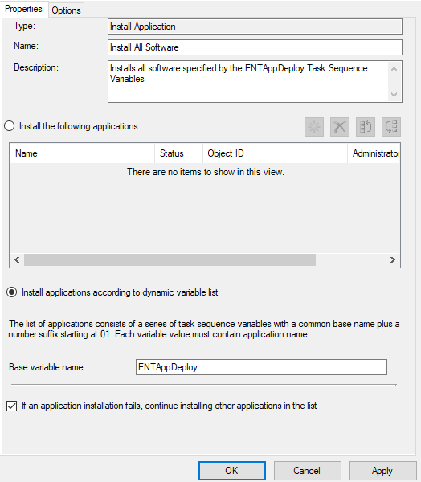
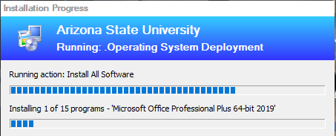
Dynamic Application Install
Final step in this process
OSD installs all applications specified using the dynamic variables created earlier

Slide 22
Putting Everything Together
SCCM Packager Script runs as a scheduled task
New Applications are packaged, distributed and deployed to a test collection
SCCM admin is notified of new application availability
New applications are tested
SCCM admin marks tested applications as “Ready”
List of tested applications is updated
OSD is run and latest applications are deployed automatically

Slide 23
Questions?

Slide 24
Thank You
SCCM Packager Script - https://github.com/asjimene/SCCM-Application-Packager
Twitter: @AndrewJimenez_

